Slide 1
Corporate Presentation
Investeurs Consulting Pvt. Ltd.

Slide 2
INDEX
Vision and Mission Statement
Company Overview
Our Services
Industry Exposure
Case Study
Our Clientele
Why Us
Leadership
Our Team
INVESTEURS

Slide 3
Vision
To be the Most Trusted Advisor Partner to our Clients in their Growth Journey
Business Motto
We serve our Clients with a motto
“Building Businesses” and focus on Strengthening their Business
Mission
To provide Professional and Committed Services to our Clients at an Optimal Cost & Terms by way of designing Solutions, backed by Delivery & Execution
INVESTEURS

Slide 4
COMPANY AT A GLANCE
One of the leading Corporate Finance Consultancy company, in existence since 1994
Advisors to Management & Top Executives to assist them in Raising Funds for their Long and Short term requirements
Company Overview
Debt Syndication: Long Term & Short Term Financing Solutions
Trade Finance: Inland, Import & Export Financing
Advisory Services: Growth Advisory & IPO Advisory
Business Verticals
Rich Legacy of 28 years
More than 700 clients, ranging from ambitious mid-size players to large size industry leaders ; few of the marquee client include Tata Sky, Chambal Fertiliser, JK Tyre, Enviro Infra, etc.
Executed over 1 lakh transactions till date and deals worth USD 36 Billion across various sectors
More than 50 Institutional Clients
Association with more than 50 Banks
Diversified Portfolio of services
Key Highlights
INVESTEURS

Slide 5
OUR SERVICES
DEBT SYNDICATION
Limit Assessment & Appraisal
Working Capital Limits (Fund Based, Non-Fund Based Limits, Structured Funding)
Project Financing, Term Loan – Greenfield & Brownfield expansion
Rating Advisory Services
TRADE FINANCE
Domestic Trade Finance:
Negotiation/Discounting of Inland Letter of Credit
Financing of Trade Receivables under Treds Platform
International Trade Finance:
Negotiation/Discounting of Import Letter of Credit - Supplier’s Credit (Negotiation & Reimbursement route)
Financing of Import Collections - Buyer’s Credit backed by SBLC
Negotiation/ Discounting of Export Letter of Credit
ADVISORY SERVICES
Growth Advisory: Building Growth roadmap & Partnering in 5 Year’s Growth journey
IPO Advisory: Assisting companies in Raising funds through IPO route
INVESTEURS

Slide 6
DEBT SYNDICATION- SERVICES
Working Capital Finance
Project Finance
Rating Advisory
Enhancement & Takeovers of –
1. Fund Based Limits - CC, WCDL, PCL, PCFC, etc.
2. Non-Fund Based Limits - LC & BG
Annual Assessment & Appraisal of Limits - Assistance in performing the Annual Appraisal of Bank Limits under Consortium, Multiple or Sole Banking Arrangement for Emerging to Mid & Large Corporates
We assist in building Financial Feasibility reports and creating TEV reports from reputed / specialized companies. We co-ordinate with funding Bank from creating reports till Sanction and Disbursement.
We have experience of raising funds for diversified industries for their Green/Brown Field projects.
We offer Rating Advisory services encompassing identification and coordination with Rating agency, compiling information, developing an optimal rating strategy and execution support for upgrading the Credit Rating from any 7 Top Credit Rating Agencies in India as on date.
INVESTEURS

Slide 7
DOMESTIC TRADE FINANCE - SERVICES
Negotiation of Inland Letter of Credit
Financing of Trade Receivables under TReDs Platform
Instrument to finance Trade transaction for a short term tenor
Secure & cost effective option which allow companies to access timely fund flow
Tenure range from 30 to 360 days depending on the trade cycle of the company (in case of Capex goods can extend upto 3 years)
Help companies in utilising their working capital more efficiently
TReDs offer Bill discounting service that improves Cash flow
RBI regulated institutional mechanism for financing trade receivables on a secure digital platform at moderate rates
Collateral free working capital using unpaid invoices through bill discounting in just 48-72 Hours
Offered without recourse to the seller and no follow-up with the buyers
Facilitates easy ERP system connectivity as data can be processed in a fraction of time
INVESTEURS

Slide 8
INTERNATIONAL TRADE FINANCE - SERVICES
Negotiation/Discounting of Import LOC – Supplier’s Credit (Negotiation & Reimbursement Route)
Financing of Import Collection – Buyer’s Credit backed by SBLC
Negotiation/ Discounting of Export Letter of Credit
Extended to importers for imports into India by overseas suppliers
Letter of credit is issued by Indian Banks under usance on behalf of their importers and it is discounted by Foreign bank and/or Indian Bank branches situated overseas.
Transaction can be executed via both “Negotiation and Reimbursement route”.
Loan for payment of imports into India arranged on behalf of the importer through an Overseas Bank
Importer may choose to avail financing in foreign currency after the shipment is done by the supplier
We have worldwide association with Banks thereby assisting in providing competitive pricing and service.
Extended to exporters for exports across the world
Letter of credit is issued by any overseas Bank under usance in favour of Indian exporters and discounted by negotiating Bank located in India at Sofr denominated/INR rates
Transaction can be executed With Recourse or Without Recourse to the Exporter.
INVESTEURS

Slide 9
ADVISORY SERVICES
Growth Advisory
IPO Advisory
Partnering with Promoters /Management to provide Advisory services in the Cos’. Growth journey from SME to Mid Corporate, by way of Financial inclusion
We advise our clients, with focus on Growth of company and assist in:
Preparing Financial dash-board, based on company’s Objective
Creating right size of funding on YOY basis
Periodically monitoring of Financial performance
Quarterly meetings with the Management to overlook Growth as per the plans
Rating assessment from the Credit Rating Agency
Assisting in Investment decision and tapping various sources of funds.
We have associated with a renowned Merchant Banker to assist companies in raising funds through IPO route. We advise on following lines –
Preparing Financial dash-board, based on company’s Growth plans
Building Valuation , based on peers multiple & various other factors
Documents collection & preparing for Due Diligence
Preparing company for Secretarial & various other Audits
Assisting company at the time of drafting of Prospectus
Resolving queries of Merchant bankers/Lawyers/Exchange/SEBI
Preparing Investor Presentation
INVESTEURS

Slide 10
WIDE INDUSTRY EXPOSURE
Mineral, Metals & Mining
Construction & Infrastructure
Electrical & Electronics
Power & Energy
Food, FMCG & Agriculture
Chemicals
Polymer
Textile
INVESTEURS

Slide 11
INDUSTRY EXPOSURE- DEBT SYNDICATION
Infrastructure
Arranged working capital finance by way of providing WC limits, especially, BG Limits for Performance, Mobilisation, Retention purpose for Infrastructure companies. Also, executed and attained financial closure for funding of HAM project
Education
Performed Project Financial Feasibility study for setting up a K-12 School, Institute, University for a renowned leading Education group – initial set up to growth stage. Raised Rupee Term lending from Banks/FI’s
Hospitality
Arranged Project Funding for one of the 5 Star Hotels, renowned chain of Hotel
Logistics
Enhanced WC limits from a Bank, along with Appraisal from Lead Bank, in regard to the Appraisal of limits – cum - Enhancement
Metal
Arranged WC limits & Structured Finance arrangement for a leading “Lead & Steel” manufacturing company, under a consortium arrangement for various converters, ferrous & non ferrous metal producers
Agri Product
Arranged Vendor Bill Discounting/Working Capital Loan for Companies dealing in Edible Oil, Rice, Pulses & other Agri Products. Arranged Warehouse Receipt Funding for an established Rice Company
Renewable Energy
Advisory & Term lending for financing of over 500 MW facility for various Indian Renewable energy independent power producer
Electronics
Project funding and WC for one of the OEMs for the branded Electronic manufacturing company
Manufacturing
Arranged WC limits, STL facilities and Unsecured Loan for a leading Wire & cable manufacturer, a Paper manufacturer and Inverter batteries manufacturer
INVESTEURS

Slide 12
INDUSTRY EXPOSURE- TRADE FINANCE
Fertilizer
Solution for Import LC discounting for 360 days with 3 or 6 months Sofr reset for imports of DAP & other chemicals
Solar
Solution for 3 Years Sofr based financing hence saving Client’s costing
Edible & Non Edible Oil
Solution for Import LC’s, ILC discounting and securing discounting lines for supplies, under High Sea Sale transaction for imports from Top 5 global suppliers
Entertainment
Solution for Import LC Discounting for 2 year Tenure for the imports of Set top box (digitalization of TV industry)
Metal
Created solution for LC discounting for leading retailer that operates hypermarkets and supermarkets in North India
Coal
Solution for Inland LC discounting up to 180 days under different structure sourcing from Coal India Ltd & subsidiaries
Arranged LC discounting for leading manufacturer of Consumer durable company & increase cash Flow to deal with major Buyers
Consumer Durable
Infrastructure
Created solutions for Inland LC discounting against their Capex LC, discounting based on running bills for making payments to vendors
Metro Projects
Created payment structure for supplies from Siemens - milestone deferred payment structure
INVESTEURS

Slide 13
CASE STUDY
Client’s status before association with Investeurs
Co. had Turnover of Rs 90 Cr approx
Banking limits of Rs 24 Cr with a single PSU bank – High interest rate, High commission, High collateral coverage
Investeurs Value Addition
Based on Promoter’s vision & understanding of sector, Investeurs assisted in Company’s growth in alignment with its vision in 3 years in following manner:
Improved Banking support, by way of introducing 5 strong New Banks for WC limit with better terms, interest rate and other commercials
Operationally engaged in day to day Banking / Servicing / Solving any issue, from “Disbursement of Limits to Issuance of LCs / BGs to handling inter Banking compliances”
Enhanced WC limits from Rs. 24 Crores to Rs. 280 Crores, in alignment with Company’s performance and winning of high value Orders
Introduced Funding by RXIL (Unsecured funding for MSME vendors)
Company’s Turnover increased over 4 times in 3 years of our association
Ideated Equity funding by way of IPO (main board) and assisted in following:
Creation of a Business & Financial model
Pitching to a Merchant Banker & Finalization of a Merchant Banker
Due diligence support to Merchant Banker & appointed Legal counsellor
Assisting Merchant banker / Lawyer in regard to queries by SEBI till approval of SEBI
Preparation of Investor PPT
Website revamping & Corporate PPT
Assisted in upgrading Credit Rating from BB+ to BBB+ from top Credit Rating Agency
Reduced collateral considerably, leading to better cash flows
Achieved sanction of Term loan for a “HAM project”; “Making Project report to Financial model to Sanction from Bank/s to Legal documentation to Disbursement”
Taking prompt actions at the time of winning of large size Projects - HAM Project (Rs. 180 Crores) & EPC Project (Rs. 1250 Crores)
INVESTEURS

Slide 14
CASE STUDY
Client’s status before association with Investeurs
Co. (operating in Infra – Road sector) had Turnover of Rs. 135 Crores
Company had Consortium Banking limits of Rs. 75 Crores with 2 PSU Bankers with:
High Interest rate & High Commission
High Collateral Coverage, almost 100%
Consortium leader wasn’t appraising rightfully as per Client’s Order positions & sectoral requirement of Bank Guarantees
Investeurs Value Addition
Based on Promoter’s vision & understanding of sector, Investeurs assisted in Company’s growth in alignment with its growth in 3 years in following manner:
Improved Banking environment / support for the company
Reduced collateral coverage to 50% based on company’s strength and Business structure
Post sanctions from 2 Banks, Investeurs handled sensitively in dismantling Consortium & provided exit to 2 existing Bankers and inducting new Bankers
Taking prompt actions by way of ensuring timely WC limits at the time of winning of a bigger Project under JV
Inducted 4 new Banks with enhanced limits as per requirement of the company, along with better commercial terms - Interest rate, Commissions, etc.
Operationally engaged in day-to-day Banking / Servicing / Solving any issue, from “Disbursement of Limits to Issuance of LCs / BGs to Legal vetting of Properties to handling inter Banking compliances.”
Enhanced WC limits from Rs. 75 Crores to Rs. 120 Crores in first year and Rs. 180 Crores in 2nd year, in alignment with Company’s performance and Order position
INVESTEURS

Slide 15
OUR CLIENTS
INVESTEURS

Slide 16
WHY US
In-depth Understanding with wide
Industry Exposure
Optimum Cost of Funds
Strive to provide the most Optimum Cost of Funds to Client
Deep Business Understanding with Multi Sector focus, solution driven mind-set and result oriented approach
Quicker Turn-Around-Time (TAT)
Excellent Client Support
IT enabled Prompt Client Servicing and Database Management makes us different from our Peers
Efficient Work Processes which results in reduction of Turn-Around-Time
Structured Solutions to suit Client’s Need
Strong Relationship with Banks & FI’s
Offer diverse and customized Financial Solutions to Clients
Strong Working Relationship with our associates including Banks and FI’s – Domestic & Overseas including PSU’s, MNC’s & Pvt. Banks
Experienced Team
New Ideas & Innovative Solutions
Perceptive & judicious team comprising of CAs and MBAs having wide and varied experience of Banking & Corporate Finance
Constantly thinking & innovating to introduce Cost Effective Structures, Products & Solutions
Established Track Record
Single Window Solution
Rich Legacy of 28 years in providing Corporate Finance Advisory Services
Single Window Solutions for all the Corporate Finance Needs
INVESTEURS

Slide 17
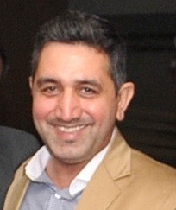
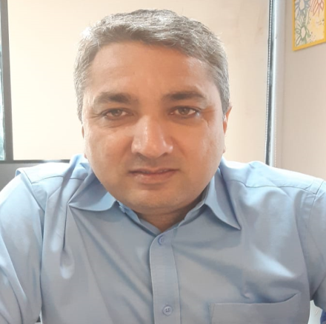
OUR LEADERS
Rich experience of 30 years plus
Driven by a desire to bring Professional approach to servicing in Corporate Finance domain, founded Investeurs in 1994
Supported creation and execution of “Turnaround Strategies” for multiple diversified firms; has significant experience of working with HNIs, Private equity firms in pre-deal diligence and post-deal strategy.
Holds a Management Degree from Amity University
Mr. Manish Dutta
Founder
Extensive experience of over 28 years of working with Emerging, Mid and Large size businesses in the areas of “Corporate financing”
Played significant role in laying the architectural framework, strategy formulation and shaping the Company’s progressive growth over the years.
Combines deep operational knowledge and broad strategic insight for delivering Client specific Solutions.
Holds Bachelors’ Honors degree in Commerce from Delhi University & a Diploma in Finance
Mr. Rajen Dutta
Co-Founder & CEO
INVESTEURS

Slide 18
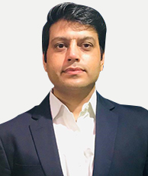
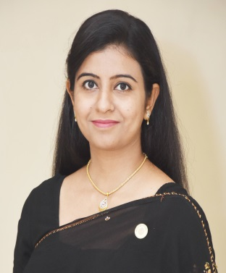
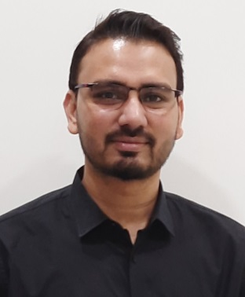
TASK MASTERS
Mr. Bijender Kumar
Mr. Ravi Kumar
Dy. Vice President
Domestic Trade Finance
Sector Expertise: 21 years
Email:
brij.k@investeurs.com
Dy. Vice President
Finance & Accounts
Sector Expertise: 21 years
Email:
ravi@investeurs.com
Mr. Navneet Chauhan
Ms. Reetika Sharma
Dy. Vice President
International Trade Finance
Sector Expertise: 19 years
Email:
navneet@investeurs.com
Asst. Vice President
Business Development
Sector Expertise: 16 years
Email:
reetika@investeurs.com
Mr. Amit Ghosh
Asst. Vice President
Debt Syndication
Sector Expertise: 10 years
Email:
amit@investeurs.com
INVESTEURS

Slide 19
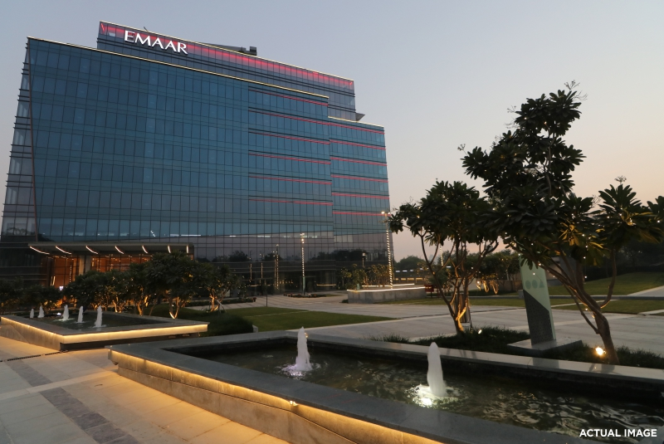
Head Office | Unit No. CT-1-05-008, Emaar Capital Tower-1 Sector 26, M.G. Road, Gurugram - 122002 +91-124-4445300–15 Fax: +91-124-4445320
Branch Office | Delhi: The Berry Coworks, 101, 27 New Delhi House, Barakhamba Road, Connaught Lane, Delhi 110001 Jaipur: M/S Suits Workspaces Pvt. Ltd., D-251, Hanumans Nagar, Vaishali, Jaipur, Rajasthan 302021
INVESTEURS

Slide 20
INVESTEURS
Building Businesses
We look forward to associate with you!
Disclaimer
This presentation is prepared exclusively for the benefit and use of Investeurs Consulting Pvt. Ltd and does not carry any right of publication or disclosure to any other party.
Neither this presentation can be assigned nor any of its contents may be used for any other purpose without prior written consent of Investeurs.
This presentation is being furnished to you solely for your information and may not be reproduced or redistributed to any other person.

